Slide 1
Algorithms (CS-204)

Slide 2
performance analysis
Why to worry about performance?
Given two algorithms for a task, how do we find out which one is better?
Naïve way is to run both the algorithms with a set of inputs

Slide 3
Depends on input
It might be possible that for some inputs, first algorithm performs better than the second. And for some inputs second performs better.
Depends on machine architecture
It might also be possible that for some inputs, first algorithm perform better on one machine and the second works better on other machine for some other inputs.
What is the alternative?

Slide 4
Doing Asymptotic Analysis rather than comparing actual time of execution in a machine.
Asymptotic analysis of an algorithm refers to defining the mathematical framing of its run-time performance. Here, we evaluate the performance of an algorithm in terms of input size. We calculate, how does the time (or space) taken by an algorithm increases with the input size.

Slide 5
Worst Case Analysis (Usually Done)
In the worst case analysis, we calculate upper bound on running time of an algorithm. We must know the case that causes maximum number of operations to be executed.
For Linear Search, the worst case happens when the element to be searched (x in the above code) is not present in the array. When x is not present, the search() functions compares it with all the elements of arr[] one by one. Therefore, the worst case time complexity of linear search would be O(n).

Slide 6
Average Case Analysis (Sometimes done)
In average case analysis, we take all possible inputs and calculate computing time for all of the inputs. Sum all the calculated values and divide the sum by total number of inputs. We must know (or predict) distribution of cases.
For the linear search problem, let us assume that all cases are uniformly distributed (including the case of x not being present in array). So we sum all the cases and divide the sum by (n+1). Following is the value of average case time complexity.

Slide 7
Best Case Analysis(Rarely done)
In best case analysis, we take the best possible input and calculate computing time for that input.
For the linear search problem, best case will be the case when the item we are looking for is found in the very first element of the array. It will take constant time irrespective of the input size.

Slide 8
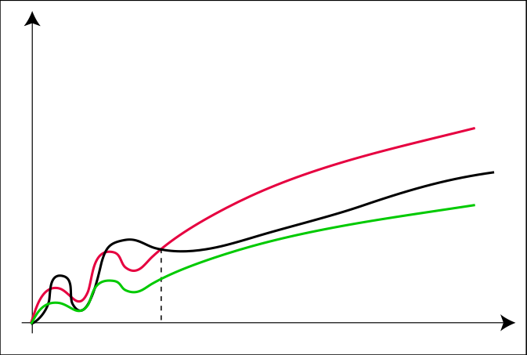
The Θ-Notation
Θ(g(n)) = { f(n) : ∃c₁, c₂ > 0, n₀ > 0 s.t. ∀n ≥ n₀: 0 ≤ c₁ · g(n) ≤ f(n) ≤ c₂ ⋅ g(n) }
c₂ ⋅ g
f
c₁ ⋅ g
n₀

Slide 9
INSERTION-SORT(A)
1 for j = 2 to A.length
2 key = A[j]
3 // Insert A[j] into the sorted sequence A[1.. j-1]
4 i = j - 1
5 while i > 0 and A[i] > key
6 A[i + 1] = A[i]
7 i = i - 1
8 A[i + 1] = key

Slide 10
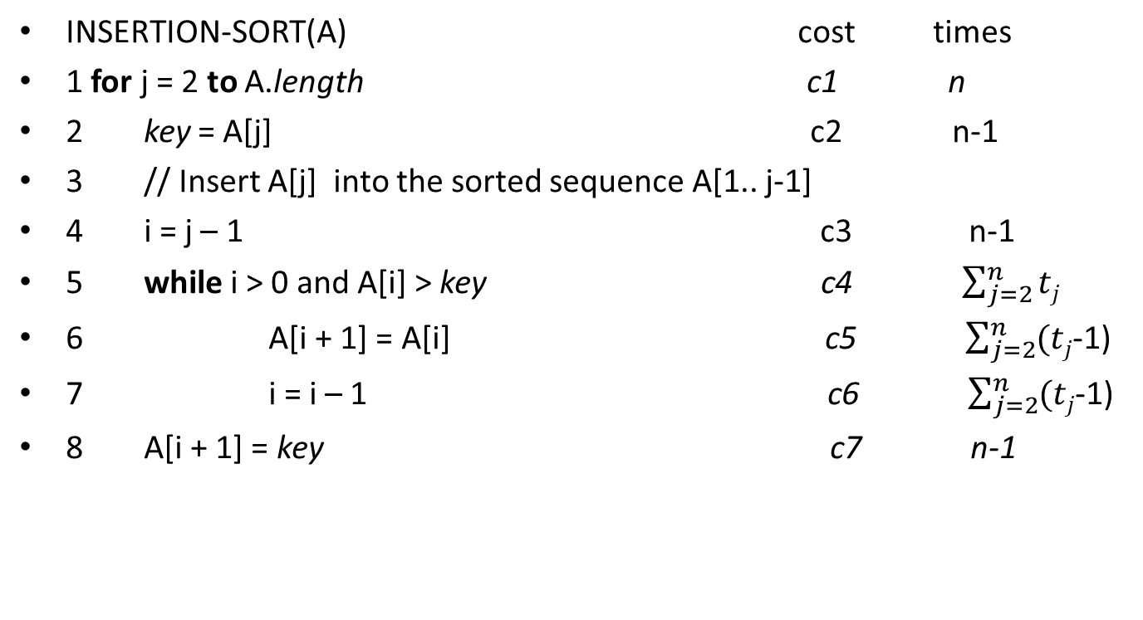
INSERTION-SORT(A) cost times
1 for j = 2 to A.length c1 n
2 key = A[j] c2 n-1
3 // Insert A[j] into the sorted sequence A[1.. j-1]
4 i = j – 1 c3 n-1
5 while i > 0 and A[i] > key c4 $\sum_{j=2}^{n}{tj}$
6 A[i + 1] = A[i] c5 $\sum_{j=2}^{n}{(tj}$-1)
7 i = i – 1 c6 $\sum_{j=2}^{n}{(tj}$-1)
8 A[i + 1] = key c7 n-1

Slide 11
Can we show ½ n² – 3n = Θ(n²)?

Slide 12
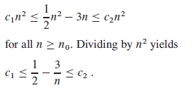
Can we show ½ n² – 3n = Θ(n²)
We can make the right-hand inequality hold for any value of n >=1 by choosing any
constant c₂ >=1/2. Likewise, we can make the left-hand inequality hold for any
value of n 7 by choosing any constant c₁ <=1/14. Thus, by choosing c₁ = 1/14, c₂ =
1/2, and n₀ = 7, we can verify that ½ n² – 3n = Θ(n²)

Slide 13
Show that 3n³ + 2n²+5n+3 = Θ(n³)
C₁n³<= 3n³ + 2n²+5n+3 <= C₂n³
C₁ <=3+2/n+5/n²+3/n³ <= C₂
If 0< C₁ <=3 for C₂ >=4 it is valid
Assuming C₁ =3 and C₂ =4 and n₀=4 it is always true
Also try 4n² + 2n +5 != Θ(n³)

Slide 14
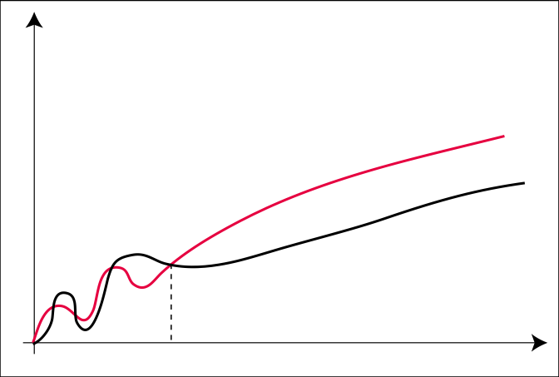
The O-Notation
O(g(n)) = { f(n) : ∃c > 0, n₀ > 0 s.t. ∀n ≥ n₀: 0 ≤ f(n) ≤ c ⋅ g(n) }
The ‚Θ-notation asymptotically bounds a function from above and below. When
we have only an asymptotic upper bound, we use O-notation.
c ⋅ g
f
n₀

Slide 15

We may also write an+b = O(n²), here the bound is not tight

Slide 16
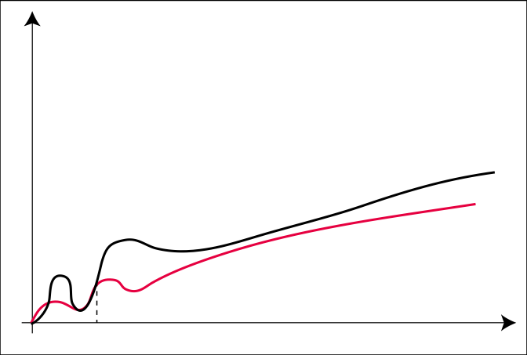
The Ω-Notation
Ω(g(n)) = { f(n) : ∃c > 0, n₀ > 0 s.t. ∀n ≥ n₀: f(n) ≥ c ⋅ g(n) ≥0}
f
c ⋅ g
n₀

Slide 17

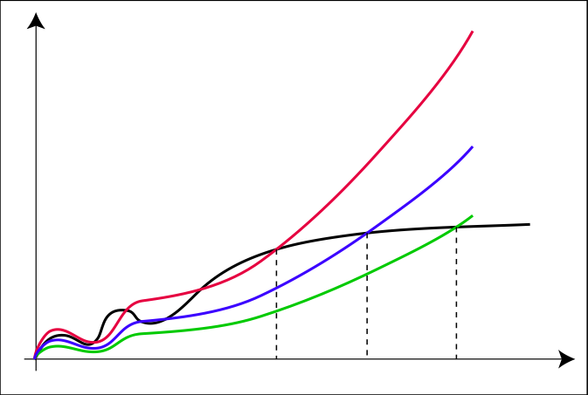
The o-Notation
o(g(n)) = { f(n) : ∀c > 0 ∃n₀ > 0 s.t. ∀n ≥ n₀: f(n) < c ⋅ g(n) }
For example, 2n = o(n²), but 2n² != o(n²).
c₃ ⋅ g
c₂ ⋅ g
c₁ ⋅ g
f
n₁
n₂
n₃

Slide 18

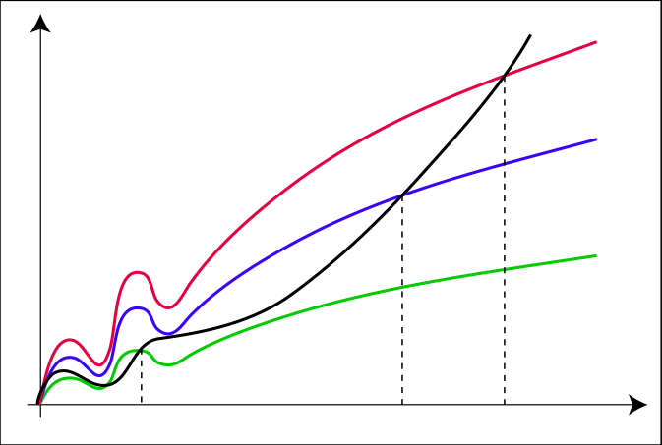
The ω-Notation
ω(g(n)) = { f(n) : ∀c > 0 ∃n₀ > 0 s.t. ∀n ≥ n₀: f(n) > c ⋅ g(n) }
For example, 2n² = ω (n), but 2n² != ω (n²).
f
c₃ ⋅ g
c₂ ⋅ g
c₁ ⋅ g
n₁
n₂
n₃

Slide 19
Asymptotic notation in equations
2n² + 3n + 1 = 2n² + Θ(n) means that 2n² + 3n + 1 = 2n² + f(n), where f (n) is some function in the set Θ(n). In this case, we let f(n) = 3n + 1, which indeed is in Θ(n).
In this way merge sort running time can be expressed as
T(n) = 2T(n/2) + Θ(n).

Slide 20
Comparison of Functions
f(n) = O(g(n)) and g(n) = O(h(n)) ⇒ f(n) = O(h(n))
f(n) = Ω(g(n)) and g(n) = Ω(h(n)) ⇒ f(n) = Ω(h(n))
f(n) = Θ(g(n)) and g(n) = Θ(h(n)) ⇒ f(n) = Θ(h(n))
f(n) = O(f(n)) f(n) = Ω(f(n)) f(n) = Θ(f(n))
Transitivity
Reflexivity

Slide 21
Comparison of Functions
f(n) = Θ(g(n)) ⇐⇒ g(n) = Θ(f(n))
f(n) = O(g(n)) ⇐⇒ g(n) = Ω(f(n))
f(n) = o(g(n)) ⇐⇒ g(n) = ω(f(n))
f(n) = O(g(n)) and f(n) = Ω(g(n)) ⇒ f(n) = Θ(g(n))
Symmetry
Transpose Symmetry

Slide 22
Does Asymptotic Analysis always work?
Asymptotic Analysis is not perfect
For example, say there are two sorting algorithms that take 1000nLogn and 2nLogn time respectively on a machine. Both of these algorithms are asymptotically same (order of growth is nLogn).
Also, in Asymptotic analysis, we always talk about input sizes larger than a constant value. It might be possible that those large inputs are never given to your software and an algorithm which is asymptotically slower, always performs better for your particular situation. So, you may end up choosing an algorithm that is Asymptotically slower but faster for your software.

